Slide 1

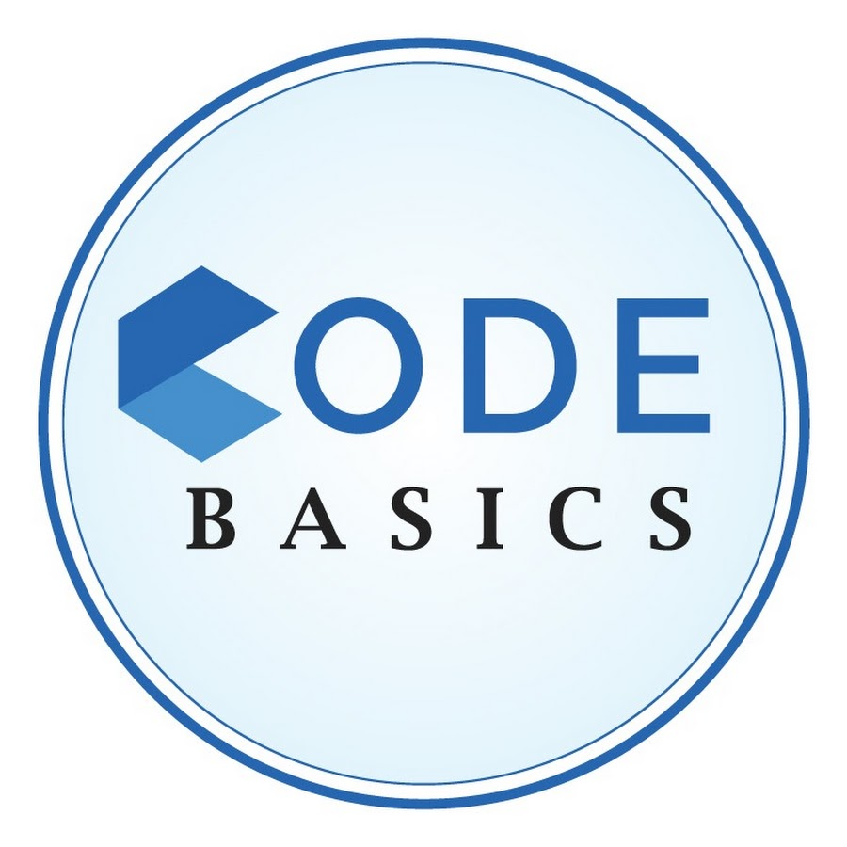
Analysis of Growth and Insights of Telangana Govt.
Presentation By
Mahesh Vaniya

Slide 2
CONTENTS OF THIS project
Challenge #7: Analyses Growth and Present Insights to the Telangana Government:
Telangana is one of the fastest-growing states in India and one of the states with an open data policy. (They have published all their data online)
Task:
perform the following task.
Check ‘research_questions_and_recommendations.pdf’. You can use any tool of your choice (Python, SQL, PowerBI, Tableau, Excel, PowerPoint) to analyze and answer these questions. More instructions are provided in this document.
Please ensure that all the insights are appropriately visualized and mapped on the Telangana district map, which will be provided as part of the input file -> ‘shape file_example.mp4’.
The target audience is top-level management - hence you need to create a convincing presentation to provide insights/recommendations. Be creative with your presentation, audio/video presentation will have more weightage.
You can use additional data based on your own research to support your recommendations.
Example LinkedIn post
Present Insights to Stakeholders and notify them. Instructions are provided in the ‘How to Notify Stakeholders.pdf’. (Important!)
Other resources Provided:
Dataset required for analysis.
Telangana district map (.json)
Metadata
Instructions for using dataset and district map.
Credits: The dataset is taken from Open Data Telangana. Thanks to the Telangana Government for providing real-time datasets for public access which is a great learning asset - feel free to explore them here. (https://data.telangana.gov.in/).

Slide 3
01 Preface
02 objectives
03 stamp registration
04 transportation
05
Ts-ipass
06 secondary research

Slide 4
preface
Telangana is one of the 28 states in india, located in the southern part of the country. Telangana has been on a path of rapid economic growth and devlopment, particularly in sectors such as IT, Pharmaceuticals, and Manufacturing. The state government has implemented several initiatives to promote industrialization and infrastructure development, making telengana an important contributor to India’s ecomic growth.

Slide 5
preface
1. Telangana has seen significant economic growth in recent years. The state's GDP grew at a rate of 15.6% in 2022-23, which is one of the highest in India. The state's per capita income has also increased significantly, from Rs. 1.45 lakh in 2014-15 to Rs. 3.17 lakh in 2022-23.
2. Telangana is also a leader in terms of human development indicators. The state has a high literacy rate and a low poverty rate. It is also ranked among the top states in terms of healthcare and infrastructure.
3. The state government has taken a number of steps to promote economic growth, such as investing in infrastructure, providing subsidies to businesses, and creating a conducive environment for entrepreneurs.

Slide 6
objective
1. Explore Stamp Registration, Transportation and
Ts-Ipass Datasets. Understand their attributes, categories and time period.
2. Analyze trends and patterns within each department.
3. Identify growth opportunities and areas needing attention.
4. Find correlation among these departments and report the overall growth of the state through insights and relevant visuals such as shape maps.

Slide 7
Stamp registration
Stamp registration in Telangana, as in many other Indian states, is governed by the Indian Stamp Act, 1899. The primary purpose of stamp registration is to ensure the legality, authenticity, and other legal instruments. The stamp registration Department of Telangana is responsible for administering stamp duties and registration processes in the state.
Revenue Generation
Property Market Development
Legal
Security
Stamp registration involves the collection of taxes on various transaction, including property sales and leases.
Proper stamp registration helps regulate the property market by ensuring transparency and legal compliance in real estate transactions.
It provides legal validation and security to property owners, It is essential for the protection of individual rights and freedoms, and for the promotion of economic growth and development.

Slide 8
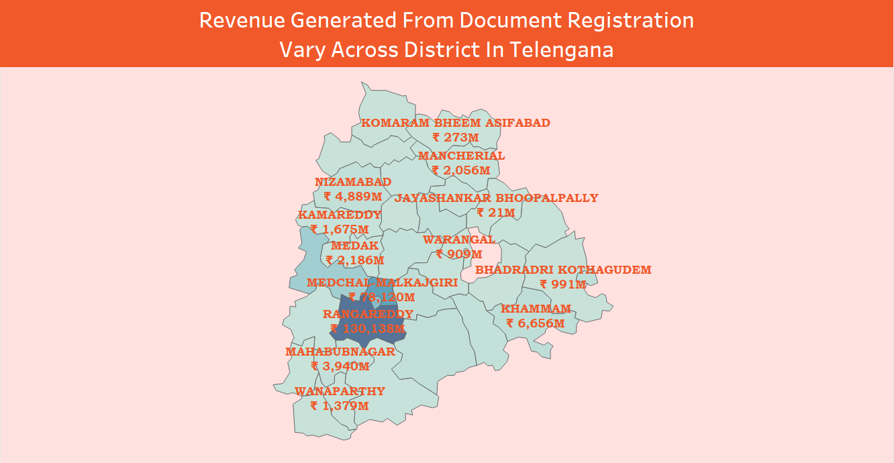
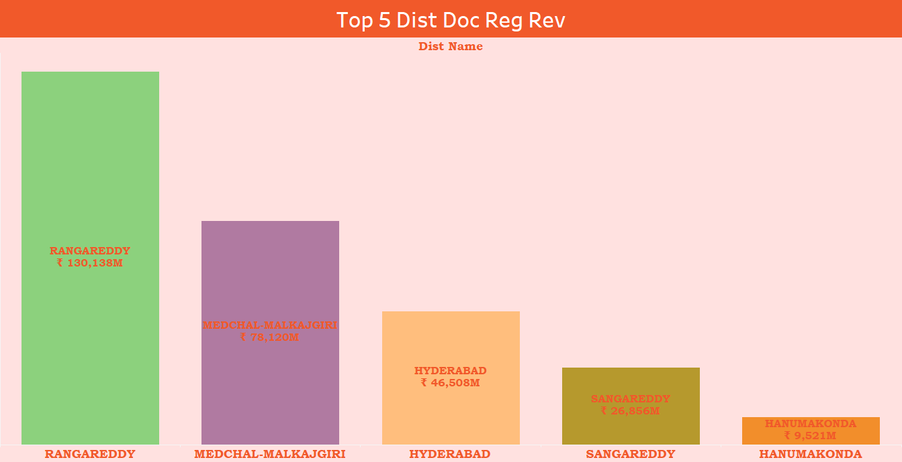
Stamp registration
How does the revenue generated from document registration vary across districts in Telangana?
List down the top 5 districts that showed the highest document registration revenue?
Total document registration revenue in 2019 is Rs. 63,583M in percentage 17.80% has increase in 2022 is Rs. 108,695M in percentage 30.43% increging.
Top 5 districts in India with the highest document registration revenue: Rangareddy, Medchal-Malkajgiri, Hyderabad, Sangareddy, Hanumakonda. This suggests that these districts are experiencing a high level of economic activity as evidenced by the high volume of property transactions taking place.

Slide 9
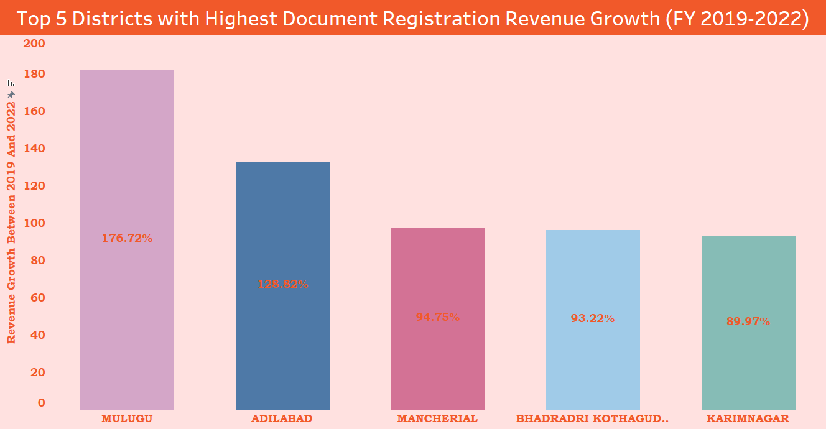
Stamp registration
List down the top 5 districts that showed the highest document registration revenue growth
between FY 2019 and 2022.
Mulugu (176.72%), Adilabad (128.82%), Mancherial (94.75%), Bhadradri Kothagudem (93.22%), Karimnagar (89.97%). This suggests that these districts are experiencing a rapid increase in economic activity, as evidenced by the high growth in property transactions. This could be due to a number of factors, such as government investment in infrastructure, new industries being set up, and increasing population growth which suggests that the state is experiencing a period of strong economic growth.

Slide 10
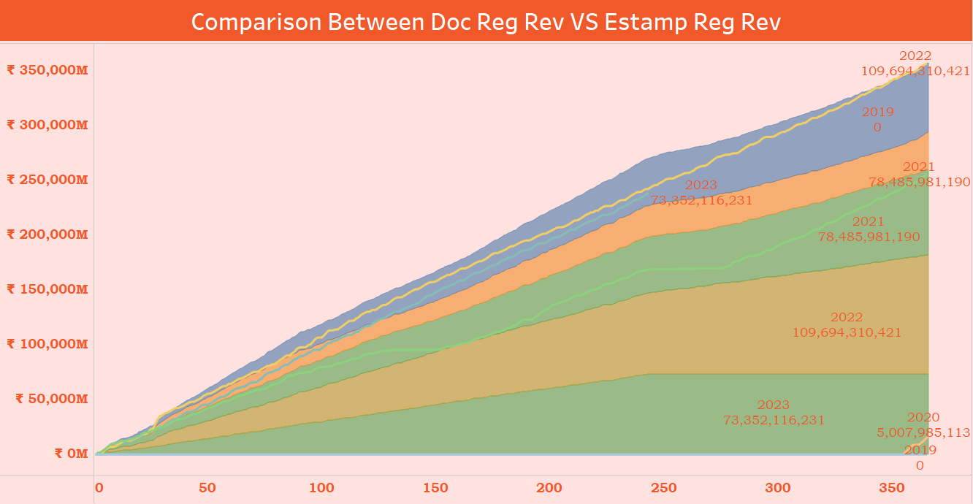
Stamp registration
How does the revenue generated from document registration compare to the revenue generated from e-stamp challans across districts ?
Revenue generated from document registration compared to revenue generated from e-stamp challans across districts (FY 2019-23): Document registration revenue: ₹ 357,162M , E-stamp challan revenue: ₹ 266,540M. This suggests that document registration is the primary source of revenue for the government from stamp duty .This is likely due to the fact that document registration is required for all property transactions, while e-stamp challans are used for a variety of other purposes, such as stamp duty on rental agreements and court fees. that provides a clear indication of the importance of document registration revenue for the government.

Slide 11
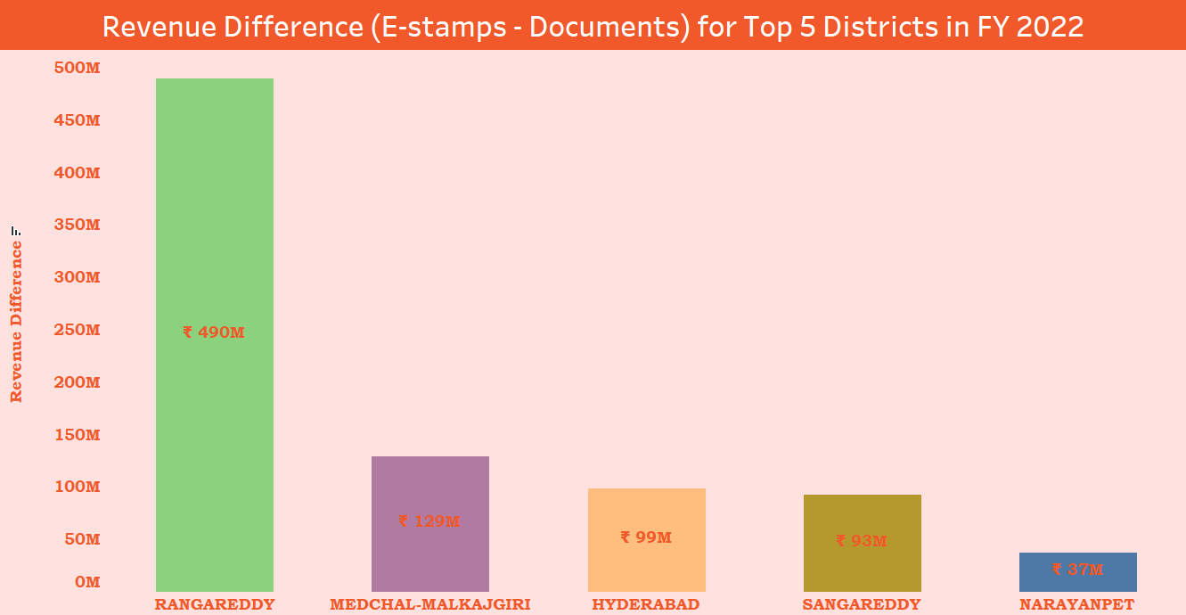
Stamp registration
List down the top 5 districts where e-stamps revenue contributes significantly more to the revenue than the documents in FY 2022?
Top 5 districts in India where e-stamps revenue contributes significantly more to the revenue than documents in FY 2022:
Rangareddy, Medchal-Malkajgiri, Hyderabad, Sangareddy, Narayanpet. This suggests that these districts are experiencing a high level of economic activity, as evidenced by the high volume of e-stamp transactions taking place. This could be due to a number of factors, such as rapid urbanization, population growth, and increasing disposable incomes. This information can be used by businesses and investors to identify areas where there is a high demand for property and other economic activity.

Slide 12
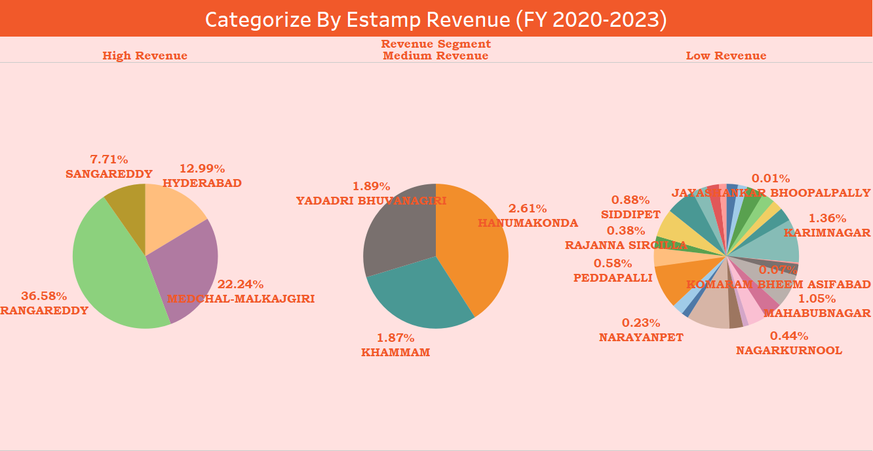
Stamp registration
Categorize districts into three segments based on their stamp registration revenue generation during the fiscal year 2019 to 2023 ?
High revenue: Rangareddy, Medchal-Malkajgiri, Hyderabad, Sangareddy Hanumkonda
Medium revenue: Hanumkonda, Yadadri Bhuvanagiri, Khammam,
Low revenue: The remaining districts
This categorization suggests that the districts in the first segment are experiencing a high level of economic activity, tha total revenue of these 4 district is 79.52% as evidenced by the high volume of property transactions taking place. The districts in the second segment are also experiencing a healthy level of economic activity, but not to the same extent as the districts in the first segment. The districts in the third segment are experiencing the lowest level of economic activity, but it is important to note that even these districts are generating significant revenue from stamp registration.

Slide 13
Stamp registration
Is there any alteration of e-Stamp challan count and document registration count pattern since the implementation of e-Stamp challan?
If so, what suggestions would you propose to the government?
Yes, there has been a significant alteration in e-Stamp challan count and document registration count pattern since the implementation of e-Stamp challan in Telangana.
Before to e-Stamp challan
Prior to the implementation of e-Stamp challan, the document registration process was manual and time-consuming. People had to visit a bank or a sub-registrar's office to purchase stamp paper and then visit the sub-registrar's office again to register their documents.
After e-Stamp challan
The introduction of e-Stamp challan has made the document registration process much easier and faster. People can now purchase e-Stamp challan online and then visit the sub-registrar's office to register their documents.
Impact of e-Stamp challan
The implementation of e-Stamp challan has had a positive impact on the document registration process in Telangana. The number of e-Stamp challan purchased has increased significantly since the implementation of e-Stamp challan. This has led to a corresponding increase in the number of documents registered in the state.

Slide 14
Stamp registration
Is there any alteration of e-Stamp challan count and document registration count pattern since the implementation of e-Stamp challan?
If so, what suggestions would you propose to the government?
Suggestions for the Telangana government:
The Telangana government can take a number of steps to further improve the e-Stamp challan system:
• Promote awareness of e-Stamp challan: The government should promote awareness of e-Stamp challan among the public. This can be done through public awareness campaigns and educational programs.
• Make e-Stamp challan more convenient: The government should make e-Stamp challan more convenient for the public. This can be done by expanding the network of banks and other institutions where e-Stamp challan can be purchased.
• Reduce the cost of e-Stamp challan: The government should reduce the cost of e-Stamp challan to make it more affordable for the public.
• Develop a mobile app for e-Stamp challan: The government can develop a mobile app for e-Stamp challan. This would make it even easier for the public to purchase e-Stamp challan.
• Integrate e-Stamp challan with other government services: The government can integrate e-Stamp challan with other government services, such as property registration and land transfer. This would make the process of registering documents and transferring land more efficient and user-friendly.

Slide 15
Transportation
Telangana has an extensive road network that includes national highways, state highways, and district roads. Several national highways, including NH-44, NH-65, and NH-163, pass through Telangana, Overall, out of the 1.51 Cr vehicles, a total of 1.11 Cr are two-wheelers, 19.45 lakh are cars,6.8 lakh are tractors and trailers,5.9 lakh are good carriages and 4.48 lakh are auto rickshaws. In Hyderabad, there are more than 77 lakh vehicles out of which over 57 lakh are tow-wheelers and 13.76 lakh are cars.
Connectivity
Supply Chain
Efficiency
Job
Creation
Efficient transportation network, including roads, railways, and airport, connect different regions, facilitating the movement of goods and people.
An effective transportation system reduces logistics costs, which is critical for the competitiveness of businesses, It enables timely and cost-effective movement of raw materials.
The development of transportation infrastructure creates jobs directly in company for sales and maintenance and indirectly by enabling economic activities in area by these network.

Slide 16
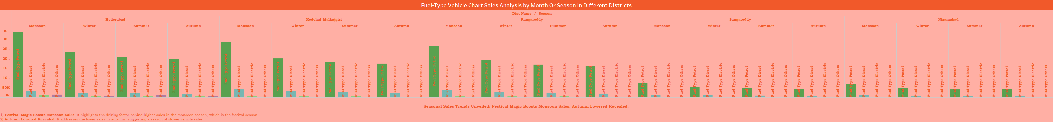
Transportation
Investigate whether there is any correlation between vehicle sales and specific months or seasons in different districts. Are there any months or seasons that consistently show higher or lower sales rate, and if yes, what could be the driving factors? (Consider Fuel-Type category only)
there is a clear correlation between vehicle sales and specific months or seasons in different districts, by fuel type.
Petrol vehicles: High sales: March, April, May, June
Low sales: December, January, February
Diesel vehicles: High sales: October, November, December
Low sales: June, July, August
Electric vehicles: High sales: September, October, November
Low sales: May, June, July. These trends are consistent across different districts in Telangana.

Slide 17
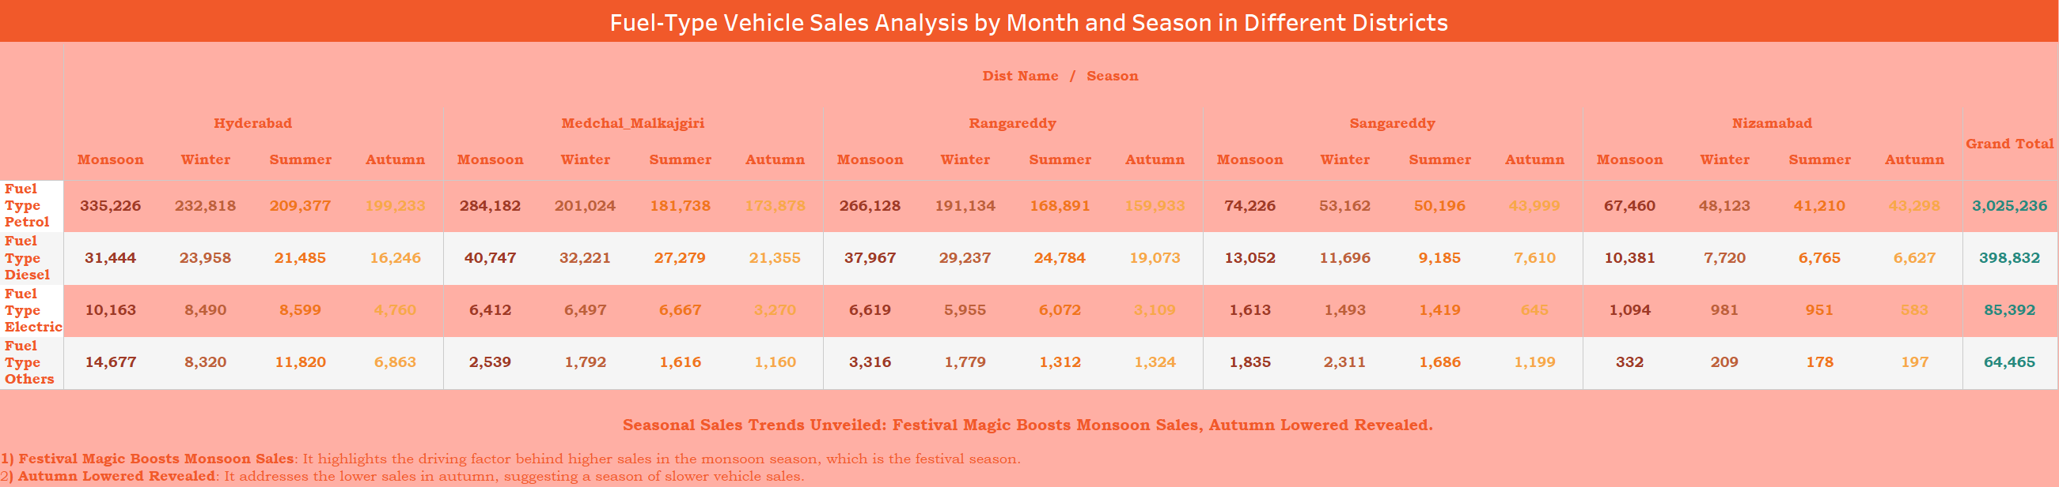
Transportation
Seasonal Sales Trends Unveiled: Festival Magic Boosts Monsoon Sales, Autumn Lowered Revealed.
1) Festival Magic Boosts Monsoon Sales: It highlights the driving factor behind higher sales in the monsoon season, which is the festival season.
2) Autumn Lowered Revealed: It addresses the lower sales in autumn, suggesting a season of slower vehicle sales.

Slide 18
Transportation
Possible driving factors:
Petrol vehicles: High sales: End of financial year: Many people purchase new vehicles at the end of the financial year to take advantage of tax benefits.
Summer holidays: People are more likely to travel during the summer holidays, which may drive up demand for vehicles.
Low sales: Winter months: People are less likely to purchase new vehicles during the winter months, due to the cold weather and shorter days.
Festive season: Many people save up for major purchases during the festive season, which can lead to a decline in vehicle sales.
Diesel vehicles: High sales: Harvest season: Farmers purchase new vehicles during the harvest season to transport their produce.
Festive season: Many people associate diesel vehicles with luxury and power, so they may be more likely to purchase them during the festive season.
Low sales: Monsoon season: The monsoon season can make roads difficult to navigate, which may discourage people from purchasing new vehicles.
Summer months: Diesel vehicles can be less fuel-efficient during the summer months, which may deter some buyers.
Electric vehicles: High sales: Festive season: Electric vehicles are becoming increasingly popular in India, and many people choose to purchase them during the festive season.
Government incentives: The Indian government offers a number of incentives to promote the purchase of electric vehicles,
which may be driving up sales during certain months of the year.
Low sales: Summer months: Electric vehicles can have a shorter range in the summer months, due to the heat.
Monsoon season: The monsoon season can damage electric vehicle charging stations, which may make it difficult for owners to keep their vehicles charged.

Slide 19
Transportation
How does the distribution of vehicles vary by vehicle class (MotorCycle, MotorCar, AutoRickshaw, Agriculture) across different districts?
Distribution of vehicles by vehicle class across different districts in FY 2022:
MotorCycles: 70%
MotorCars: 10-20%
AutoRickshaws: 5-10%
Agriculture: <5%

Slide 20
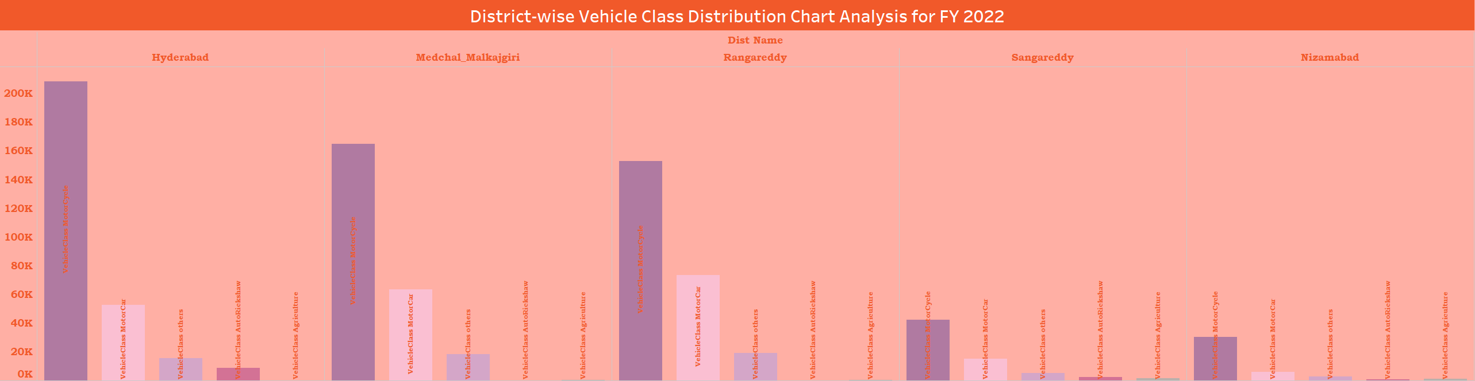
Transportation
Are there any districts with a predominant preference for a specific vehicle class? Consider FY 2022 for analysis.
Districts with a predominant preference for a specific vehicle class:
MotorCycles: Hyderabad
MotorCars: Rangareddy
AutoRickshaws: Hyderabad
Agriculture: Nalgonda
Other: Rangareddy

Slide 21
Transportation
Are there any districts with a predominant preference for a specific vehicle class? Consider FY 2022 for analysis.
1) For MotorCycle category
"In FY 2022, District Hyderabad Embraces Two-Wheeled Freedom: Motorcycles Reign Supreme"
This emphasizes that Motorcycles are the favored vehicle class in Hyderabad during the fiscal year 2022,
showcasing a strong preference for two-wheeled transportation in the district.
2) For Motorcar Category
"In FY 2022, District Rangareddy Rolls in Style: Motorcars Lead the Way"
This highlights that Motorcars are the preferred vehicle class in Rangareddy during the fiscal year 2022,
indicating a strong inclination towards four-wheeled transportation in the district.
3) For Auto rickshaws Category
"Hyderabad District's Top Choice in 2022: Auto rickshaws Lead the Way"
This highlights that Auto rickshaws are the primary vehicle class of choice in Hyderabad for the year 2022,
suggesting a notable preference for this mode of transportation in the district.
4) For Agricultural Category
"Nalgonda District's Agricultural Vehicle Preference in 2022"
This indicates that in 2022, Nalgonda District demonstrates a significant preference for agricultural vehicles,
suggesting a strong agricultural presence or demand in the district.
5) Other category
"Rangareddy District's Unique Vehicle Preference in 2022"
This implies that in 2022, Rangareddy District exhibits a distinctive preference for a specific "other" vehicle class,
highlighting a potentially unique market or transportation need in the district.

Slide 22
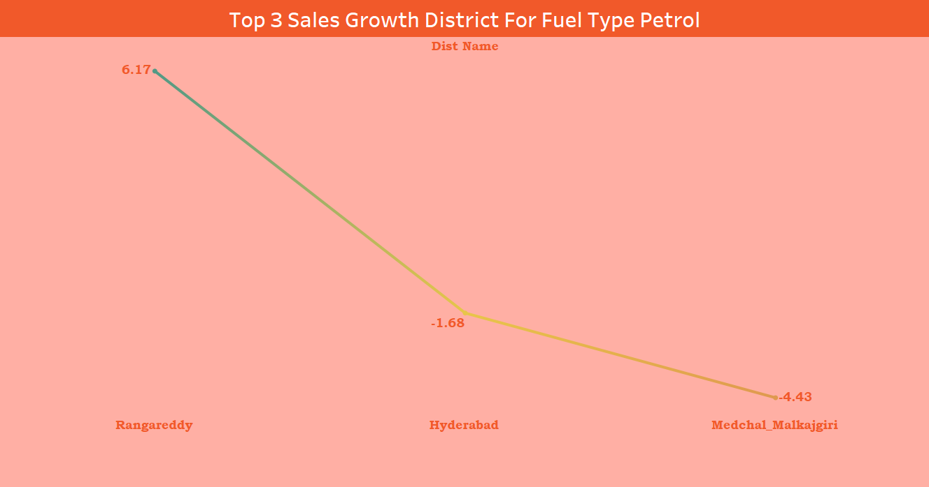
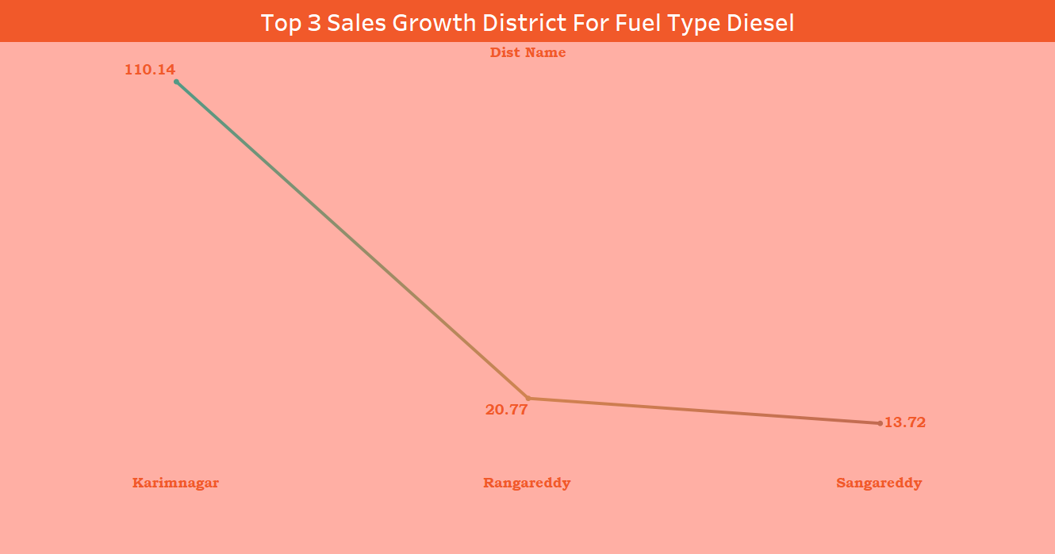
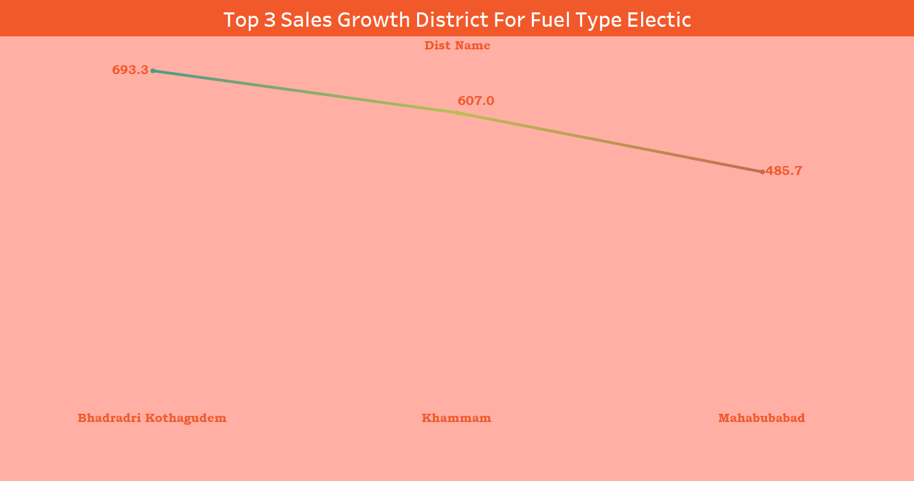
Transportation
List down the top 3 and bottom 3 districts that have shown the highest and lowest vehicle sales growth during FY 2022 compared to FY 2021? (Consider and compare categories: Petrol, Diesel and Electric)
Top 3
Petrol
Diesel
Electric
Rangareddy (6.17%)
Hyderabad (-1.68%)
Medchal-malkajgiri (-4.43%)
Karimnagar (110.14%)
Rangareddy (20.70%)
Sangareddy (13.7%)
Bhadradri kothagudem (693.3%)
Khammam (607.0%)
Mahabubabad (485.7%)

Slide 23
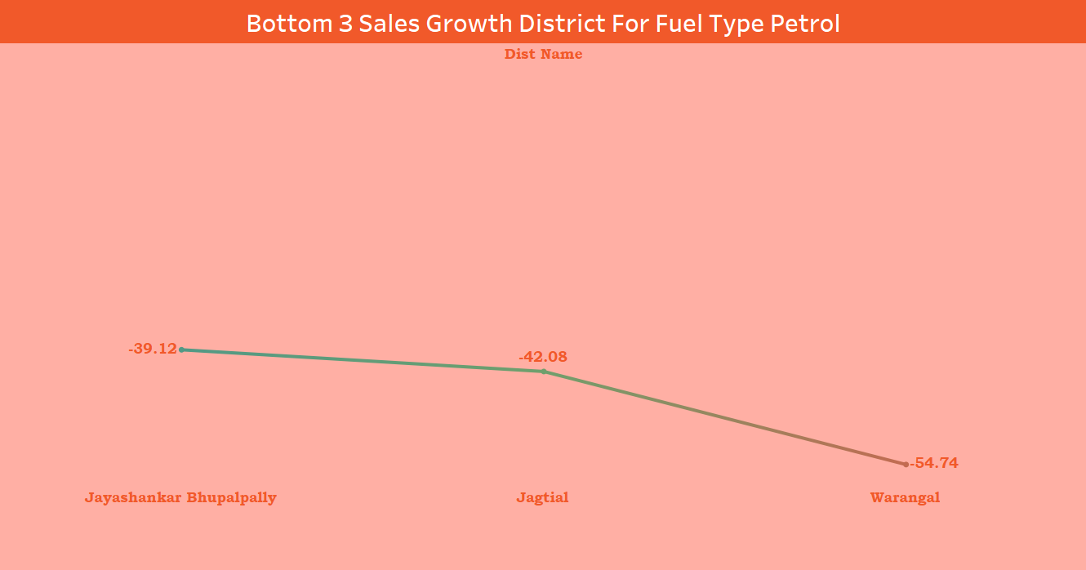
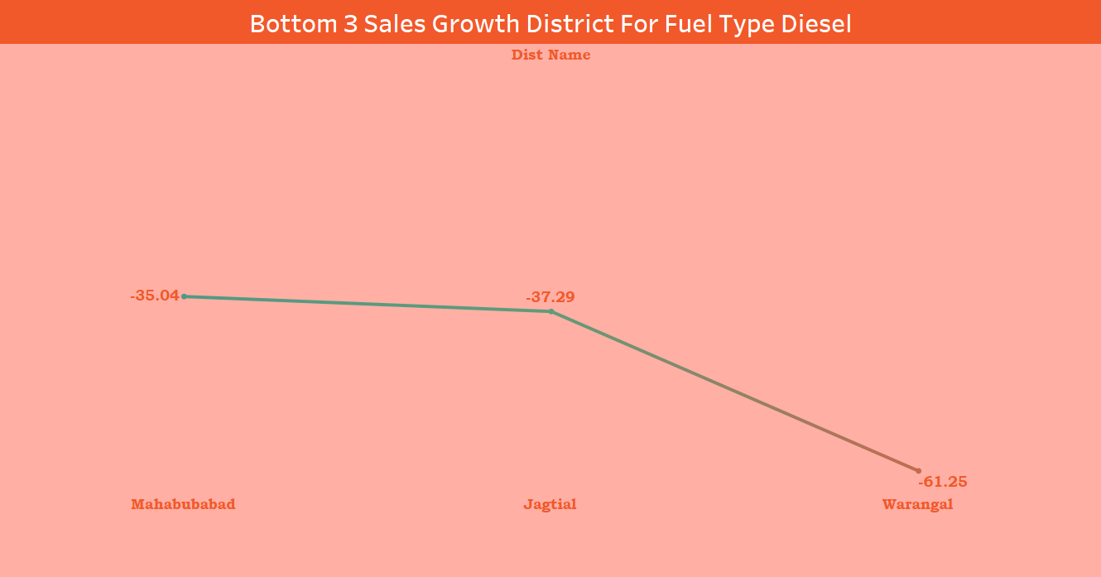
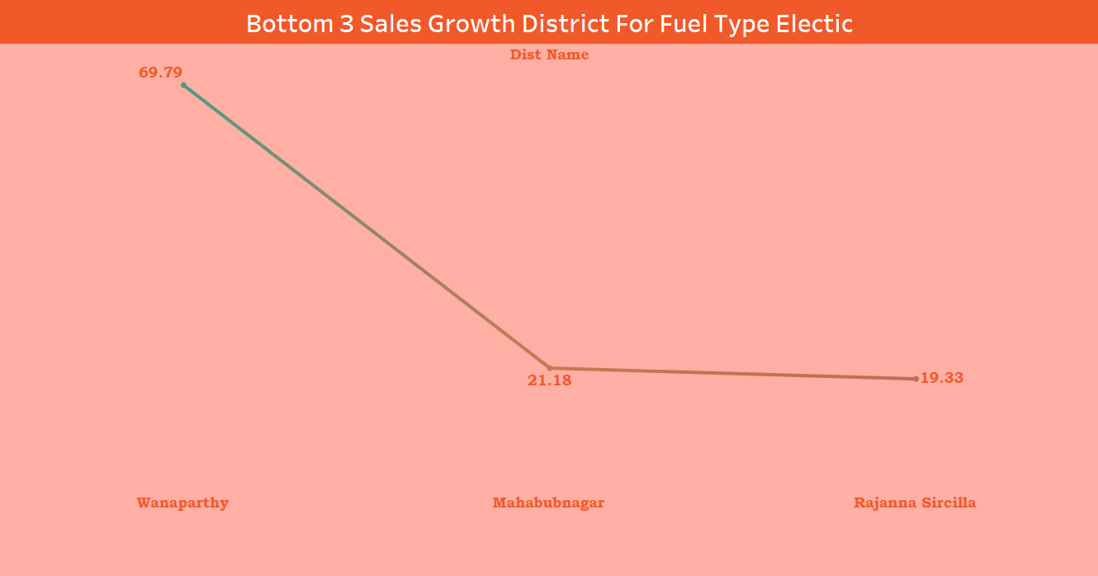
Transportation
List down the top 3 and bottom 3 districts that have shown the highest and lowest vehicle sales growth during FY 2022 compared to FY 2021? (Consider and compare categories: Petrol, Diesel and Electric)
Bottom 3
Petrol
Diesel
Electric
Jayshankar bhupalpalu
(-39.12%)
Jagtial (-42.08%)
Warangal (-54.74%)
Mahabubabad (-35.29%)
Jagtail (-37.29%)
Warangal (-61.25%)
Wanaparthy (69.79%)
Mahabubnagar (21.18%)
Rajanna sircilla (19.13%)

Slide 24
Ts-ipass
Telangana State Industrial Project Approval and Self-Certification System(TS-iPASS) was statutorily enacted in 2014 The Act. The central purpose of the act is to mandate industrial clearances with in a pre-established time span, including penalties if clearance applications are not processed with in said time span. Telangana through its flagship initiative of TS-iPASS has attracted 22,745 industries so far, investments of Rs. 2,60,060 Cr and created employment for 17.54 lakhs people.
Ease of doing
business
Industrial
expansion
Economic
diversification
TA-iPASS simplifies and expedites the approval process for setting up industries in Telangana. This ease of doing business attracts both domestic and foreign investment.
By reducing bureaucratic hurdles and promoting self-certification, TS-iPASS encourages existing industries to expand their operations, contributing to increased production and employment products.
TS-iPASS encourages diversification into various sectors, promoting and resilient economy beyond traditional industries.

Slide 25
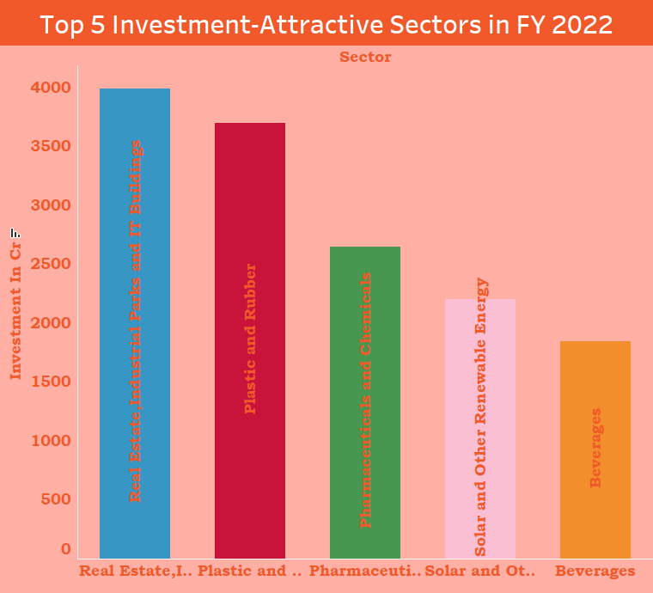
Ts-ipass
List down the top 5 sectors that have witnessed the most significant investments in FY 2022.
Top 5 investment-attractive sectors in FY 2022:
Real Estate,Industrial Parks and IT Buildings,
Plastics and rubber,
Pharmaceuticals and Chemicals,
Solar and Other Renewable Energy,
Beverages

Slide 26
Ts-ipass
List down the top 5 sectors that have witnessed the most significant investments in FY 2022
Top 5 investment-attractive sectors in FY 2022: Real Estate,Industrial Parks and IT Buildings, Plastics and rubber, Pharmaceuticals and Chemicals, Solar and Other Renewable Energy, Beverages
Real estate: The Telangana real estate sector is expected to grow at a CAGR of over 10% in the coming years, driven by factors such as urbanization, rising disposable incomes, and government initiatives.
Plastics and rubber: The Telangana plastics and rubber sector is expected to grow at a CAGR of over 8% in the coming years,
driven by factors such as increasing demand from the automotive, packaging, and construction industries.
Pharmaceuticals: The Telangana pharmaceutical sector is expected to grow at a CAGR of over 12% in the coming years,
driven by factors such as increasing demand from domestic and international markets, and government support for the sector.
Solar and Other Renewable Energy: The Telangana solar and off-grid sector is expected to grow at a CAGR of over 20% in the coming years, driven by factors such as government support for renewable energy, and declining costs of solar panels and batteries.
Beverages: The Telangana beverages sector is expected to grow at a CAGR of over 10% in the coming years,
driven by factors such as rising disposable incomes, changing lifestyles, and increasing demand for non-alcoholic beverages.
Overall, the top 5 investment-attractive sectors in FY 2022 offer a number of attractive investment opportunities for investors
looking to capitalize on the growth of the Telangana economy.

Slide 27
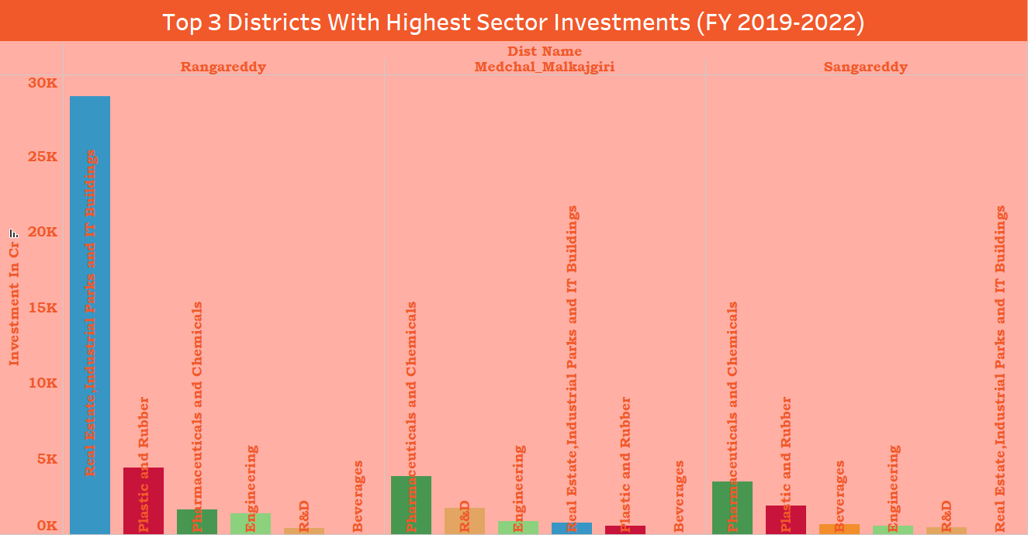
Ts-ipass
List down the top 3 districts that have attracted the most significant sector investments during FY 2019 to 2022? What factors could have led to the substantial investments in these particular districts?
Top 3 districts that have attracted the most significant sector investments during FY 2019 to 2022:
Rangareddy, Medchal-Malkajgiri, Sangareddy
Factors that have led to the substantial investments in these particular districts:
Infrastructure, Skilled workforce, Government support, Presence of large industries and IT companies
For example,Rangareddy is home to the Hyderabad Airport and a number of IT parks, which has made it a hub for the IT and ITES industries. Medchal-Malkajgiri is home to a number of pharmaceutical companies, which has made it a hub for the pharmaceutical industry.
Sangareddy is home to a number of manufacturing companies, which has made it a hub for the manufacturing sector.

Slide 28
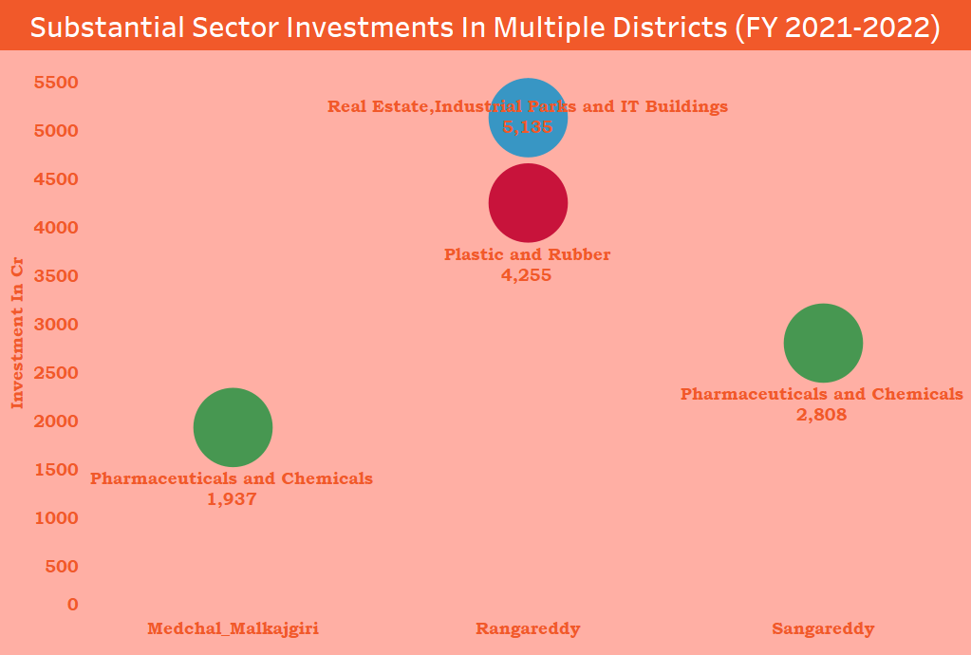
Ts-ipass
Are there any particular sectors that have shown substantial investment in multiple districts between FY 2021 and 2022?
Particular sectors that have shown substantial investment in multiple districts between FY 2021 and 2022:
Real Estate, Industrial Parks and IT Buildings
Plastics and rubber
Pharmaceuticals and Chemicals
These sectors have attracted significant investment due to a number of factors, including rapid urbanization, population growth, the presence of a large number of companies in these sectors, and government support.

Slide 29
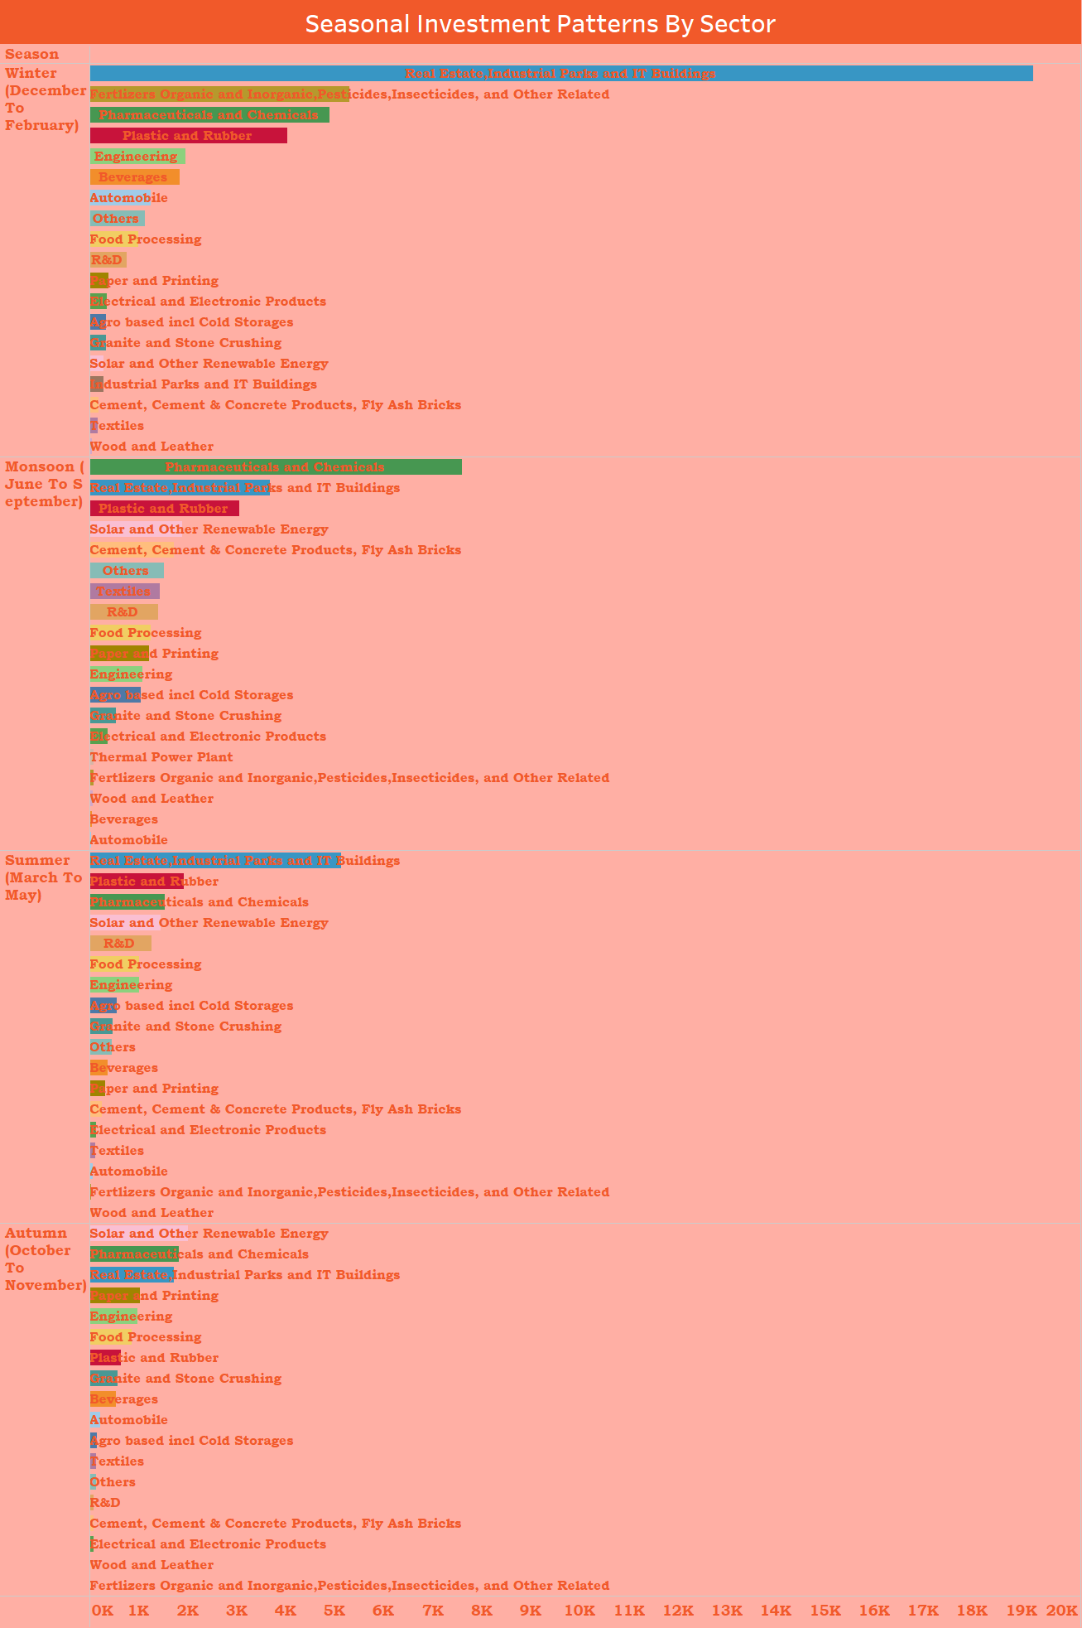
Ts-ipass
Can we identify any seasonal patterns or cyclicality in the investment trends for specific sectors? Do certain sectors experience higher investments during particular months?
Most of investment is between December to February it’s Winter season.
The Sector like Real estate, industrial parks and it building, Pharmaceuticals and chemicals, Plastic and Rubber experience higher investments during particular months.

Slide 30
Ts-ipass
Is there any relationship between district investments, vehiclessales and stamps revenue within the
Same district between FY 2021 and 2022?
Yes, there is a relationship between district investments, vehicle sales, and stamps revenue within the same district between
FY 2021 and 2022 in Telangana.
District investments
District investments are a measure of the economic activity in a district. When businesses invest in a district, they create jobs and generate income.
This leads to increased demand for goods and services, which in turn drives economic growth.
Vehicle sales
Vehicle sales are a measure of the consumer spending in a district. When people buy vehicles, it indicates that they have disposable income and
are confident about the future. Vehicle sales are also a good indicator of economic growth.
Stamps revenue
Stamps revenue is a measure of the real estate activity in a district. When people buy property, they have to pay stamp duty to the government. Stamps revenue is a good indicator of the economic activity in a district, especially in the real estate sector.
Relationship between district investments, vehicle sales, and stamps revenue There is a positive relationship between district investments, vehicle sales, and stamps revenue. When district investments increase, it leads to increased economic activity, which in turn drives up vehicle sales and stamps revenue.
In FY 2022, the Rangareddy district of Telangana attracted the highest investment in the state. The district also had the highest vehicle sales and stamps revenue in the state. This suggests that there is a strong relationship between district investments, vehicle sales, and stamps revenue.

Slide 31
Secondary Research
What are the top 5 districts to buy commercial properties in Telangana?
Justify your answer.
1. Hyderabad: Hyderabad is the capital and largest city of Telangana. It is a major IT hub and is home to many multinational companies. The city also has a strong manufacturing and pharmaceutical sector. Hyderabad is well-connected to other parts of India and the world by air, rail, and road.
2. Rangareddy: Rangareddy district is located on the outskirts of Hyderabad and is home to many IT and manufacturing companies. The district is also well-connected to Hyderabad by road and rail.
3. Medchal-Malkajgiri: Medchal-Malkajgiri district is located on the northern outskirts of Hyderabad and is home to many IT and manufacturing companies. The district is also well-connected to Hyderabad by road and rail.
4. Suryapet: Suryapet district is located in the southern part of Telangana and is home to many manufacturing and pharmaceutical companies.
5. Warangal Urban: Warangal Urban district is the second largest city in Telangana and is home to many IT and manufacturing companies.

Slide 32
Secondary Research
What are the top 5 districts to buy commercial properties in Telangana?
Justify your answer.
The districts listed above have a number of factors that make them attractive for commercial property investment:
• Strong economic growth: These districts are all located in the economically fastest-growing region of Telangana.
• Favorable business environment: The Telangana government has implemented a number of reforms to create a more business-friendly environment in these districts.
• Good infrastructure: These districts have good infrastructure, including roads, railways, airports, and energy.
• Skilled workforce: These districts have a large and growing pool of skilled workers.
• Strategic location: These districts are strategically located within Telangana and have easy access to major markets and resources.

Slide 33
Secondary Research
What significant policies or initiatives were put into effect to enhance economic growth, investments,
and employment in Telangana by the current government? Can we quantify the impact of these policies using available data?
The Telangana government has implemented a number of significant policies and initiatives to enhance economic growth, investments, and employment in the state. These include:
• TS-iPASS: TS-iPASS is a single-window system that streamlines the approval process for new businesses. It has reduced the time required to set up a new business in Telangana from several months to a few days.
impact of this policie:
the number of new businesses registered in Telangana has increased significantly since the launch of TS-iPASS. In 2014-15, 174 new businesses were registered in the state. This number increased to 3184 in 2022-23.
• TS-bPASS: TS-bPASS is a similar system that streamlines the approval process for building construction. It has reduced the time required to obtain a building permit from several weeks to a few days.
impact of this policie:
the number of building permits issued in Telangana has also increased significantly since the launch of TS-bPASS. In 2020-21, 4,872 building permits were issued in the state. This number increased to 13,748 in 2022-23.
• Rythu Bandhu: Rythu Bandhu is a direct cash transfer scheme that provides financial assistance to farmers. It is one of the largest such schemes in the country.
impact of this policie:
The Rythu Bandhu scheme has also had a positive impact on the agricultural sector. The state's agricultural GSDP has increased from Rs. 76,123 crore in 2014-15 to over Rs. 2,17,983 crore in 2022-23.

Slide 34
Secondary Research
Provide top 5 Insights & 5 recommendations to Telangana government for sustained growth in the next 5 years based on your analysis.
Top 5 Insights for Telangana government for sustained growth in the next 5 years:
1. Strong economic growth: Telangana has been one of the fastest-growing states in India in recent years, with an average rate of growth of GSDP (current prices), at 12.1%, was 1.3% less than India’s average between 2014-15 and 2022-23. This growth has been driven by a strong performance in sectors such as IT, manufacturing, and pharmaceuticals.
2. Improving infrastructure: Telangana has made significant investments in infrastructure in recent years, including roads, railways, airports, and energy. This has improved the state's connectivity and attractiveness to businesses and investors.
3. Favorable business environment: Telangana has implemented a number of reforms to create a more business-friendly environment. These include streamlining the approval process for new businesses, reducing the regulatory burden, and providing tax incentives.
4. Skilled workforce: Telangana has a large and growing pool of skilled workers, thanks to its investments in education and training. This has made the state a desirable destination for businesses looking to set up or expand operations.
5. Strategic location: Telangana is strategically located in the heart of India, with easy access to major markets and resources. This makes it an ideal hub for businesses looking to serve the Indian market and beyond.

Slide 35
Secondary Research
Provide top 5 Insights & 5 recommendations to Telangana government for sustained growth in the next 5 years based on your analysis.
Top 5 Recommendations to Telangana government for sustained growth in the next 5 years:
1. Continue to invest in infrastructure: Telangana should continue to invest in infrastructure to improve connectivity and
attract businesses and investors. This could include investments in roads, railways, airports, energy, and water resources.
2.Focus on high-growth sectors: Telangana should focus on developing high-growth sectors such as Real Estate,Industrial Parks
and IT Buildings , Plastic and Rubber, manufacturing, pharmaceuticals, and tourism. This could include providing incentives
to businesses in these sectors, investing in research and development, and developing skilled workers.
3.Promote innovation and entrepreneurship: Telangana should promote innovation and entrepreneurship by creating an
ecosystem that supports startups and small businesses. This could include providing access to capital, mentorship, and networking opportunities.
4.Invest in education and skill development: Telangana should continue to invest in education and skill development to
create a workforce that is prepared for the jobs of the future. This could include expanding access to quality education,
providing vocational training, and partnering with industry to develop skill-based programs.
5.Promote sustainable development: Telangana should promote sustainable development by integrating environmental considerations into its economic policies. This could include investing in renewable energy, developing green infrastructure, and promoting sustainable practices in agriculture and industry.
By implementing these recommendations, Telangana can continue to achieve sustained growth in the next 5 years and beyond.

Slide 36

Does anyone have any questions?
vvmahesh82@gmail.com

